Slide 1


Team 2020
Super Vandal World
Status Report
Members:
Ben : IT Manager
Justin : Software Architect
Heba : Quality Assurance Manager Davey : Project Manager John : AI Specialist Keller : Version Control Manager

Slide 2
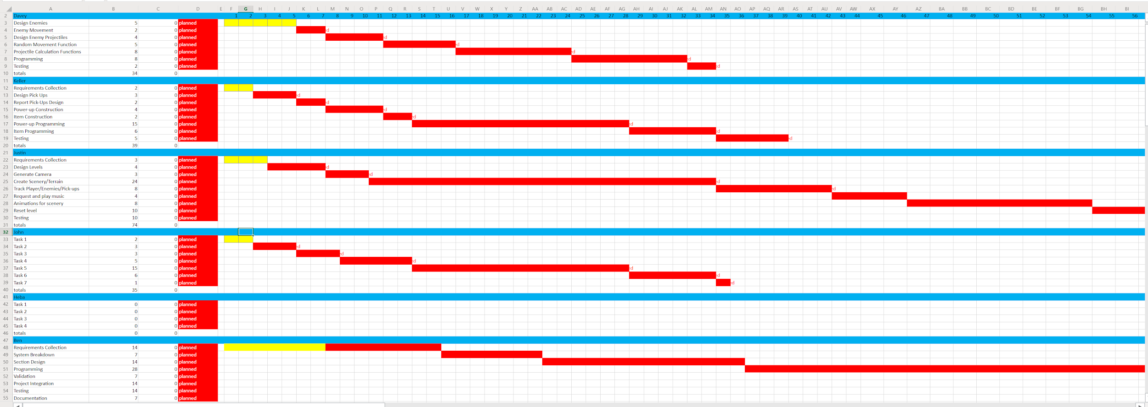
https://vandalsuidaho-my.sharepoint.com/:x:/g/personal/angu7936_vandals_uidaho_edu/ESwW7DUrar5Btsyqpne1lZoB-VRVyVAlue0cf-k1a9rLpg?rtime=5bbRuFRg2Eg

Slide 3
Budget
Project Status: On Schedule
Expenses: $2,700
Projected Expenses to completion: $72,900

